Slide 1
WP2 Use Case
All Hands Meeting
Sergei Gorianin
frequenteen@gmail.com

Slide 2
Use Case Motivation
Each clinical study may generate, amongst other things:
A study protocol (needed, amongst other things, for ethical approval)
Consent forms and Participant Information Sheets.
A variety of analysis datasets, often including sub-study data
Related datasets from laboratories (biomarkers, gene expression, etc.) or from imaging facilities
Usually a detailed data management plan (DMP).
A statistical analysis plan (SAP), (less so in exploratory studies)
A variety of published papers, at different time points
Descriptive metadata, of the various data sets
Inclusion in a meta-analysis
(N.B. Standardisation of data items and structures is proceeding but slowly, especially in the non-commercial sector.)

Slide 3
Use Case Motivation
The different research studies and data objects will often be in different places… (with the original research team, on a website, in published papers, on preprint servers, in an institutional, disease-specific or general repository)
The mechanisms for gaining access will vary between different places and different data objects.
But there is no agreed discovery metadata schema that can be used to describe data objects and the access mechanisms associated with them, and there is no central repository of that metadata.
Finding out what data objects are available, what studies they are linked to, how to access them, or apply for access, is therefore a difficult, time-consuming process. As the practice of data sharing increases, this problem is likely to rapidly increase.

Slide 4
Use Case Goals: Objectives
Investigate the most efficient mechanisms for assigning identifiers to clinical research data objects (e.g. DOIs)
Investigate the applicability of the proposed metadata scheme, developing it further if necessary
Develop a simple web based system for collecting metadata, and assess its acceptability to researchers (metadata repository)
Investigate storage, access and maintenance issues and costs of the metadata repository, envisaged as being based on the Indigo cloud infrastructure
Develop a web based portal to search the repository, including user acceptance testing of the portal
Investigate API based harvesting techniques and data mining techniques and assess their suitability for longer term use
Develop options for a sustainable metadata repository system using a well defined combination of tools, procedures and infrastructures

Slide 5
Use Case Goals: Concept
A metadata repository, implemented as single portal system, should allow:
Identification of clinical research studies (e.g. via clinical trial registries)
Display and selection of data objects related to a specific clinical study
Display of metadata of a data object, including nature of the object (e.g. name, type, provenance) and the mode of access (public, restricted, private)
Link to the data object (if possible)

Slide 6
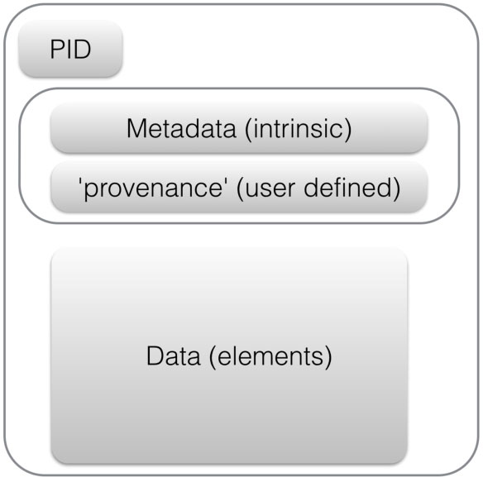
Use Case: Concept
Unique identifier
Patient-level data in a repository
Clinical trial
Data in regulatory databases (e.g. EMA)
Data objects
Summary results in clinical trial registry
Statistical analysis plan on trial webpage
Trial protocol published in journal
Fair principles

Slide 7
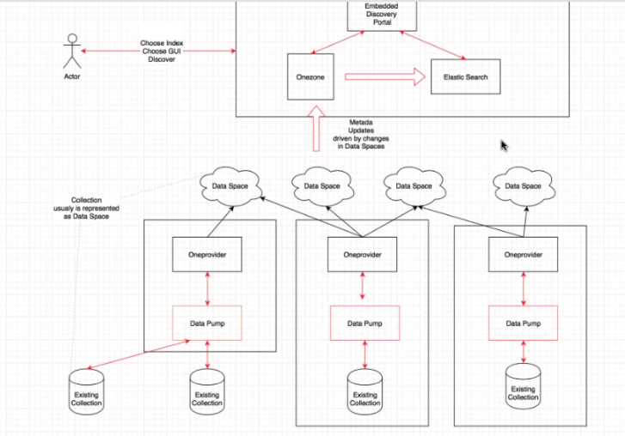
Use Case Goals: Architecture
ECRIN – OneData Integration Architecture

Slide 8
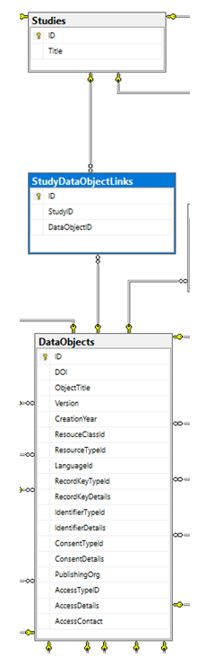
Use Case Goals: Data structures
The two main entities in the system are:
Studies;
Data Objects, with a join table linking the two.

Slide 9
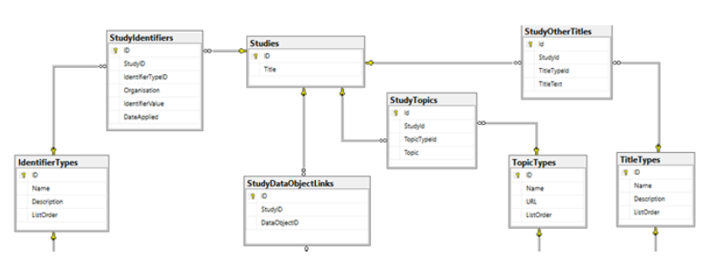
Use Case Goals: Data structures
Study related data

Slide 10
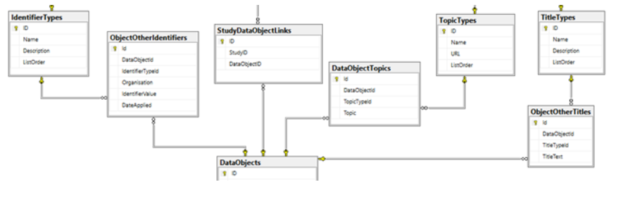
Use Case Goals: Data structures
The Data Object data has equivalent links to identifiers, topics and alternative titles

Slide 11
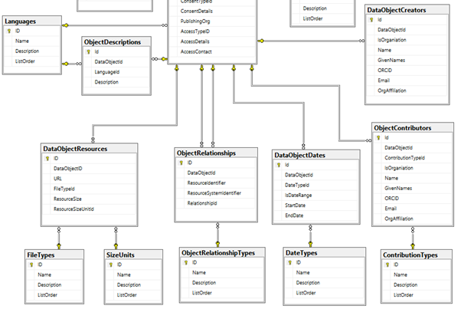
Use Case Goals: Data structures

Slide 12
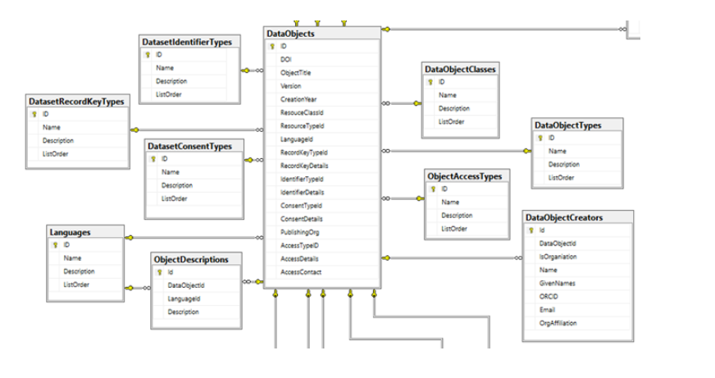
Use Case Goals: Metadata schema

Slide 13
Use Case Goals: Data sources
Type of data source | Examples
Clinical trial registry | WHO ICTRP, ClinicalTrials.gov
Bibliographic DB | Pubmed, Crossref
Regulatory bodies | EudraCT
Generic repository | ZENODO, Dryad
Clinical trial repository | Vivli
Disease-specific repository | NIH BioLINCC, Malaria Group Oxford
Stakeholder-specific repository | CSDR, YODA
Institutional repository | Edinburgh, Kings London
Other sources | OpenTrials

Slide 14
Use Case Goals: Acquiration
Data import of full database & metadata
Harvesting metadata via OAI-PMH
Crawling webpages

Slide 15
Use Case Update: Current status
Configured testbed server for collecting and importing data from different data sources;
Already imported data from WHO ICTRP Database (last updated);
Already imported data from PubMed – 200k rows;
Already imported data from Zenodo (ClinicalTrials registry, ICTRP registry (2015-2016 years)).

Slide 16
Use Case Update: Testbed server
Characteristics:
Ubuntu server 16.04;
32 Gb RAM;
16 VCPUs;
Disk space 20 Gb by default + possibility to extend up to 1.5 Tb.
Components:
Python and PHP languages;
Apache, Nginx;
MySQL and MongoDB databases;
Anaconda packages for Python;
R language support.

Slide 17
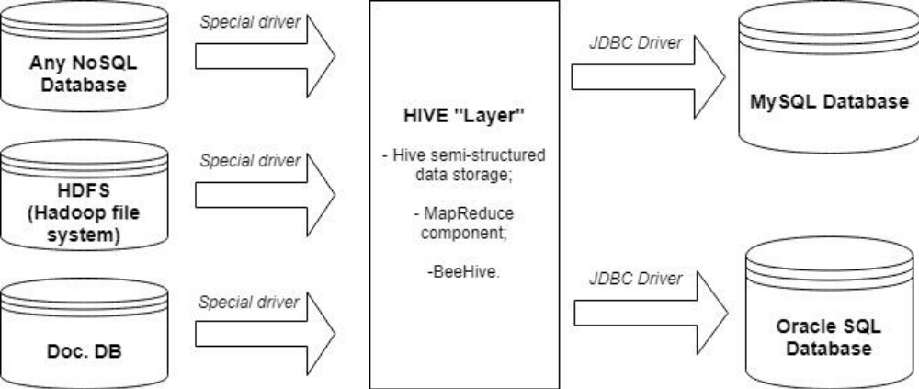
Use Case Update
Proposed architecture for the test bed server

Slide 18
Potential Stoppers
Process of cooperation between ECRIN and OneData has started. It has to be demonstrated that OneData is able to develop and provide the functionality needed for the portal, including the front end.
There may be problems in the acquisition of specific data sources if they are not public. We will try to negotiate but it may be that some significant data sources are missing in the pilot.

Slide 19
Work plan: For the coming months
Import few more data sources (3-4 or more);
Develop the demo search engine;
Collaborate with other projects.

