Slide 1



ECRIN work in eXtreme Data Cloud (XDC): Clinical trial metadata repository
XDC Workshop
17 January 2019, Paris
Christian Ohmann (ECRIN)

Slide 2
eXtreme dataCloud (XDC): ECRIN use case
Concept
A metadata repository (MDR), implemented as single portal system, should allow
Identification of clinical research studies (e.g. via clinical trial registries)
Display and selection of data objects related to a specific clinical study
Display of metadata of a data object, including nature of the object (e.g. name, type, provenance) and the mode of access (public, restricted, private).
Link to the data object (if possible)

Slide 3
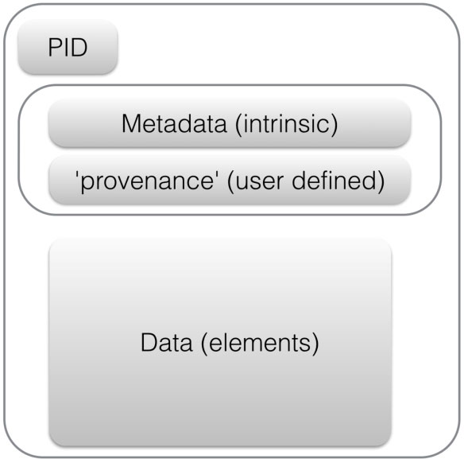
eXtreme dataCloud (XDC): ECRIN use case
Concept
Unique identifier
Patient-level data in a repository
Clinical trial
Data in regulatory databases (e.g. EMA)
Data objects
Summary results in clinical trial registry
Statistical analysis plan on trial webpage
Trial protocol published in journal
Fair principles

Slide 4
eXtreme dataCloud (XDC): ECRIN use case
Use case specification*
Use case description
Goals
Requirements
Data sources
Targeted metadata schema
Data structures
User interaction & design (see mock-up)
*see confluence: https://confluence.extreme-datacloud.eu/display/XDCPROJ/ECRIN+Use+Case

Slide 5
eXtreme dataCloud (XDC): ECRIN use case
Data sources

Slide 6

eXtreme dataCloud (XDC): ECRIN use case
Type of data sources for the pilot
Disease-specific repository
(e.g. Malaria)
Meta data repository
(MDR)
Institut-ional repository
(e.g. UK)
Trial-specific repository
(e.g. Vivli)
Generic repository(e.g. ZENODO))
Biblio-graphic DB
(e.g. PubMed)
Regulatory DB
(EudraCT)
Registry
(e.g. Clinical Trials.gov)

Slide 7
eXtreme dataCloud (XDC): ECRIN use cases
Data sources for the pilot
Type of data source | Examples
Clinical trial registry | WHO ICTRP
Bibliographic DB | Pubmed, Crossref
Regulatory bodies | EudraCT
Generic repository | ZENODO, Data Dryad, Figshare
Clinical trial repository | Vivli
Disease-specific repository | NIH BioLINCC, Malaria WWARN
Stakeholder-specific repository | CSDR, YODA
Institutional repository | Edinburgh DataShare
Other sources | OpenTrials
*italics: planned to be integrated

Slide 8
eXtreme dataCloud (XDC): ECRIN use case
Type of data sources covered so far
Data source | Type of data source | Metadata schema | Metadata down-loadable | No of records | Time period covered | Size | Last extraction date
WHO ICTPR | Trial registry | none | From full DB
Pubmed | Bibliographic DB | Dublin Core elements | API-services OAI-MPH | 35894 | ? | 67.6 MB | 30.11.2018
ZENODO | Generic repository | DataCite with enrichments | API-services OAI-PMH | 33457 | 2010-2018 | 57 MB | 6.12.2018
Bio-LINCC | NIH-Repository | none | No, metadata provided by data source | 1563 | ? | 15.4 MB | 21.12.2018
Data Dryad | Repository of datasets | Dublin Core Metadata Initiative Abstract Model (DCAM) | API-services OAI-MPH | 4675 | 2012-2018 | 27.4 MB | 16.12.2018
WWARN | Repository of datasets | None | No | ? | ? | ? | ?
Edinburgh DataShare | Institutional data repository | Modified Dublin Core Metadata Schema | API-services OAI-PMH | 130 | 2010-2018 | 4.3 MB | 30.12.2018

Slide 9
eXtreme dataCloud (XDC): ECRIN use case
Metadata mapping

Slide 10
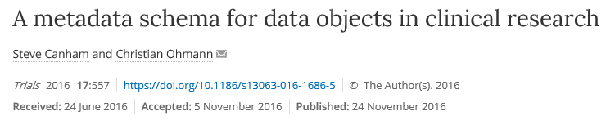
eXtreme dataCloud (XDC): ECRIN use case
Objective of a metadata scheme
To develop and agree on a simple standardized metadata scheme that can
a) identify the study or studies that are related to each data object,
b) characterise the data object
c) describe where and how that data object can be accessed.
One such scheme, extending the existing DataCite metadata scheme, is proposed:

Slide 11
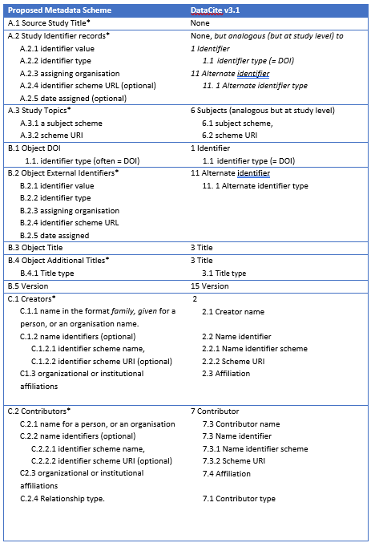
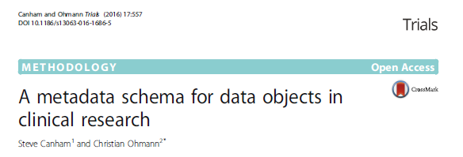
eXtreme dataCloud (XDC): ECRIN use case
Proposed metadata scheme*
*Canham, Ohmann, Trials 2016; 17:557

Slide 12
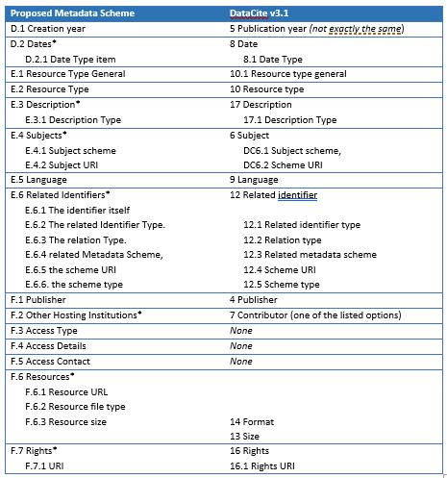
eXtreme dataCloud (XDC): ECRIN use case
Proposed metadata scheme*
*Canham, Ohmann, Trials 2016; 17:557

Slide 13
eXtreme dataCloud (XDC): ECRIN use case
Metadata mapping between ECRIN schema and WWARN
ECRIN metadata | WWARN metadata
A.1 Source Study Type | Publication title
A.2 Study identifiers | Pubmed ID
A.3 Study Topics
A.4 Other Study Titles
B.1 DOI
B.2 Object title
B.3 Version
B.4 Object Other Identifiers
B.5 Object Additional Titles
C.1 Creators
C.2 Contributors
D.1 Creation Year
D.2 Dates
E.1 Resource Class | dataset
E.2 Resource Type | curated and anonymised dataset
E.3 Record Key Type | 2
E.4 Identifier Type | 2 (de-identified)
E.5 Associated Content
E.6 Description
E.7 Language
E.8 Related Resource Identifiers
E.9 Topics (of data object)
F.1 Publisher/Provider | WWARN
F.2 Access Type | restricted download
F.3 Access Details | contributor control or data access committee control
F.4 Access Contact | WWARN
F.5 Resources
F.6 Rights

Slide 14
eXtreme dataCloud (XDC): ECRIN use case
Metadata mapping between ECRIN schema and BioLINCC
ECRIN metadata | BioLINNC metadata
A.1 Source Study Type | name
A.2 Study identifiers
A.3 Study Topics | keywords
A.4 Other Study Titles | slug, acronym
B.1 DOI
B.2 Object title | dataset of name
B.3 Version
B.4 Object Other Identifiers
B.5 Object Additional Titles
C.1 Creators | study_contact_name (?)
C.2 Contributors
D.1 Creation Year | created from data_open_data
D.2 Dates | date_open_data (date data made available), date modified
E.1 Resource Class | dataset if has data = yes
E.2 Resource Type | final analysis set (?) if has data = yes
E.3 Record Key Type | 2 if is_public_use_dataset = yes
E.4 Identifier Type | 2 (de-identified)
E.5 Associated Content | 3 (?)
E.6 Description
E.7 Language | english (per se)
E.8 Related Resource Identifiers
E.9 Topics (of data object)
F.1 Publisher/Provider | BioLINCC
F.2 Access Type | restricted download
F.3 Access Details
F.4 Access Contact | BioLINCC
F.5 Resources
F.6 Rights | data_restrictions_commuse = yes

Slide 15
eXtreme dataCloud (XDC): ECRIN use case
Metadata mapping between MDR and data sources
Service provider
Metadata
Repository (MDR)
Metadata
Harvester
request
receive
WHO ICTPR
Pubmed
ZENODO
BioLINCC
WWARN
Metadata/
resources
Metadata/
resources
Metadata/
resources
Metadata/
resources
Metadata/
resources
…….
Data provider
Data provider
Data provider
Data provider
Data provider

Slide 16
eXtreme dataCloud (XDC): ECRIN use case
Approaches to acquire metadata (data)
Data import of full data base & metadata
Harvesting metadata via OAI-PMH
Crawling webpages
etc.

Slide 17
eXtreme dataCloud (XDC): ECRIN use case
Harvesting metadata with OAI-PMH
Metadata
Repository (MDR)
Request (http)
Metadata/resources
Metadata
Harvester
OAI-PMH
Metadata (XML)
Data provider
Service provider
Data Sources
Pubmed
Edinb. DataShare
etc.

